Slide 1








International Islamic University Chittagong
Department of Computer Science & Engineering
Operating Systems Lab
Welcome to Our Group Project Presentation ON
CPU Scheduling in Operating Systems
Course Teacher - G.M. Al-Arafat Shaown
Assistant lecturer at
International Islamic University Chittagong

Slide 2







Meet Our Team
(Team_Bro-buggers)
Imon Shahriar
(ID: C211029-6CM)
Shovan Bhattacharjee (ID: C211010-6CM)
Arif Rahman
(ID: C211024-6CM)

Slide 3





Introduction
We collaborated with peers in our 6th semester OS Lab course, code CSE-3632, to develop this group project analyzing fundamental CPU scheduling algorithms that govern process ordering and resource allocation in operating systems.

Slide 4

Project overview
FCFS
CPU Sheduling
SJF
OS Algorithm
SRTF
Round Robin
Priority (Preemptive)
Priority(Non-Preemptive)
DeadLock
Banker’s Algorithm

Slide 5

Our Website Homepage

Slide 6

Objectives
Here in our project, we have shown
CPU SCHEDULING
DEADLOCK FUNCTIONALITY (Banker’s Algorithm)

Slide 7
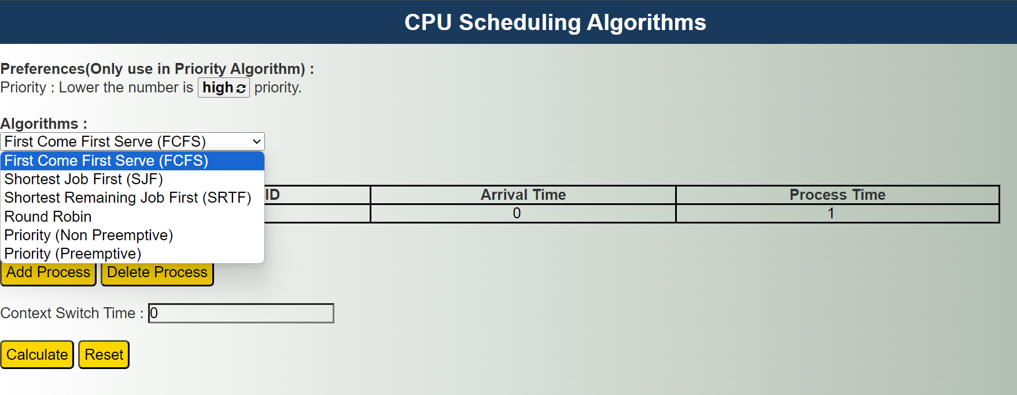
Name of all the Algorithms

Slide 8
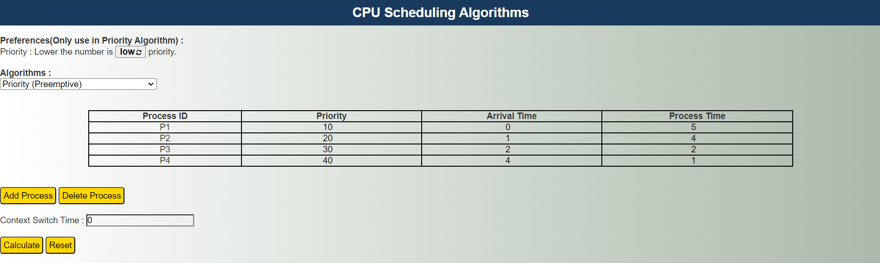
Implementing Priority (PreemPtive) Algorithm

Slide 9
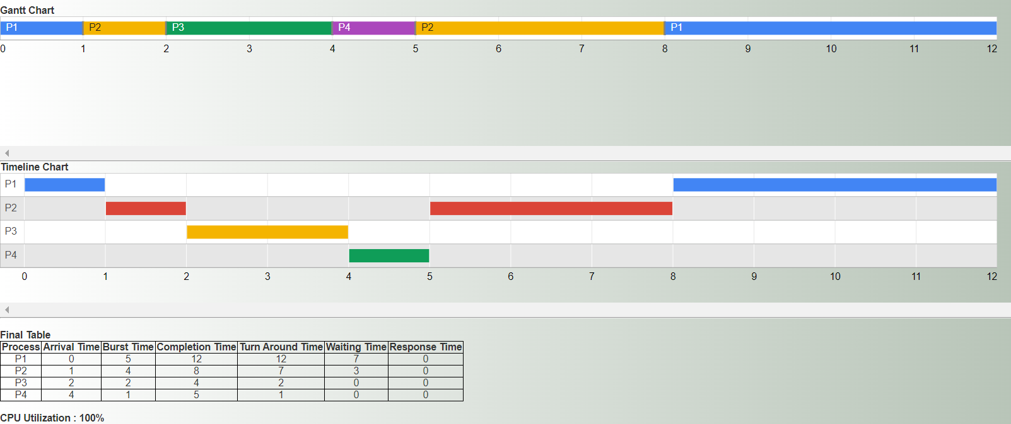
Showing Gantt Chart, Timeline Chart, Final Table and CPU Utilization
The same kind of timeline visualization for CPU scheduling methods is displayed by both a Gantt chart and a timeline chart, which show which CPUs are used by which tasks at different times. A CPU that has a 100% CPU utilization rate is one that is actively running processes 100% of the time during a specific time frame.

Slide 10
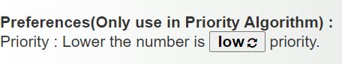
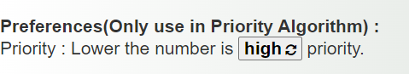
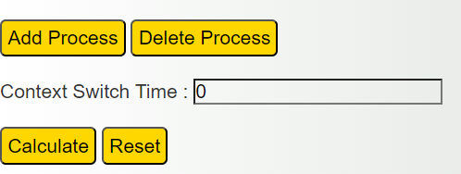
Different Functionalities
Priority is a numeric value associated with a process.
The scheduler uses this priority value to decide which process should run next.
The scheduler uses these priorities for both (Preemptive and Non-Preemptive) scheduling decisions.
Context Switch Time:
The overhead time taken to swap out one process and swap in another.
Occurs when stopping the current process and saving its state to resume the scheduler.

Slide 11
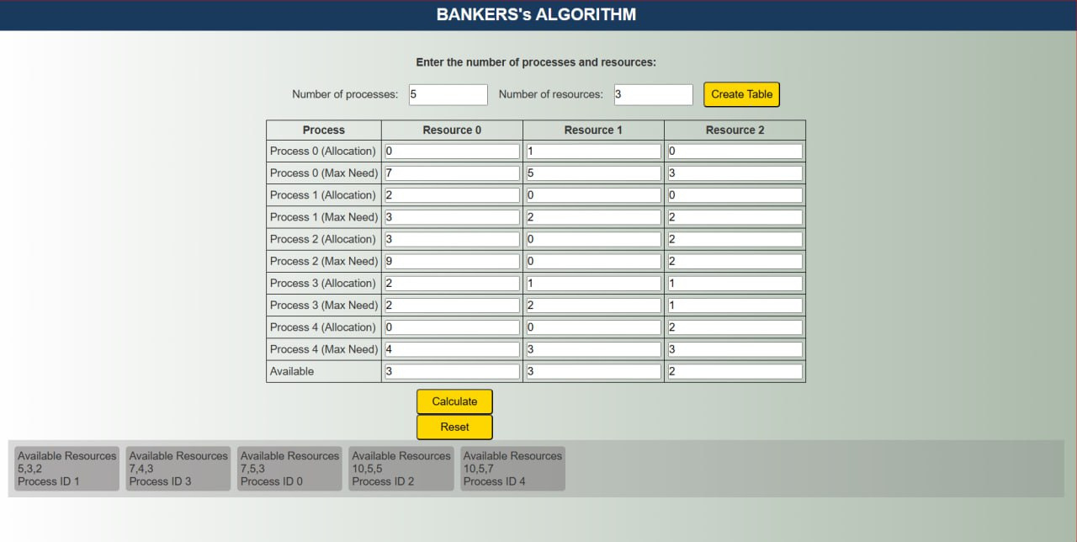
DeadLock (Bankers Algorithm)
Deadlocks happen when processes get stuck waiting indefinitely for resources, creating a circular chain of dependency that prevents any progress.
The banker's algorithm is a deadlock avoidance technique that only allocates resources if the system can guarantee a safe backout sequence to recover them later, ensuring at least one execution sequence remains.

Slide 12





Project Related Software & languages
We Use
Language
Software
For Better Visualization
https://team-bro-buggers-c211010.github.io/CPU-Scheduling-IIUC-OS-Project/

Slide 13


THANK YOU

